Slide 1
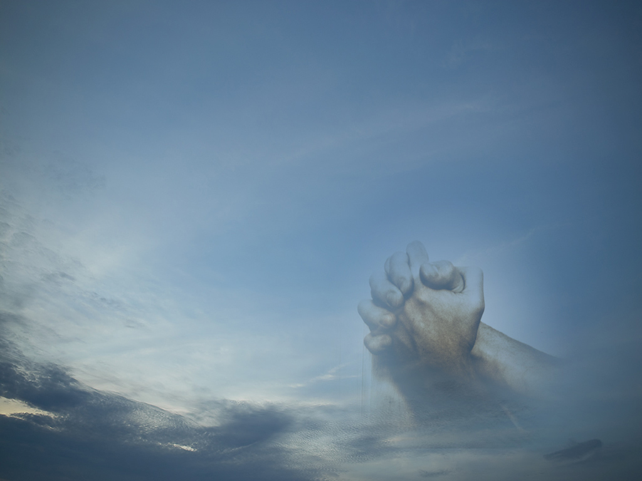
WORSHIP:
Life’s Greatest Moments
Ascribe to the LORD, O families of the peoples,
ascribe to the LORD glory and strength!
Ascribe to the LORD the glory due his name;
bring an offering, and come into his courts!
Worship the LORD in the splendor of holiness;
tremble before him, all the earth!
Psalm 96:7-9

Slide 2
WORSHIP: Life’s Greatest Moments
Worship is Not…
Every activity in our lives…
  We may serve Him through different activities but that is service and not worship.
  Luke 17:7-10
Worship involves expressing and sharing with God in ways acceptable to Him (1Pet.2:5) our appreciation for what He means to us.

Slide 3
WORSHIP: Life’s Greatest Moments
Worship includes…
Glorifying God…
  Isaiah 60:21b; 61:3b; 66:5; Psalm 22:23; 29:2; 86:12; Matthew 5:16; 9:8, etc.
Expressing Awe…
  Psalm 33:8; Matthew 9:8; Hebrews 12:28
Magnifying God…
  Psalm 35:27; 40:16; 70:4; Malachi 1:5; Acts 19:17
Honoring Him…
  Isaiah 29:13; Rom.1:21; 1Tim.6:16; Rev.4:9,11;5:12,13

Slide 4
WORSHIP: Life’s Greatest Moments
Worship includes…
Reverencing Him…
  Psalm 2:11; 5:7; 119:38; Hebrews 12:28
Blessing Him…
  Psalm 16:7; 26:12
Praising Him…
  Isa.42:8,10,12; Psalm 30:4; 40:3; Lk.19:37; Acts 2:47
Exalting Him…
  Psalm 18:46; 21:13

Slide 5
WORSHIP: Life’s Greatest Moments
Worship includes…
Rejoicing in Him…
  Psalm 35:9; 63:11; Philippians 4:4
Thanking Him…
  Psalm 7:17; 9:1; Luke 17:6; Colossians 3:17

Slide 6

WORSHIP:
Life’s Greatest Moments
Ascribe to the LORD, O sons of the mighty,
Ascribe to the LORD glory and strength!
Ascribe to the LORD the glory due his name;
Worship the LORD in holy array
Psalm 29:1,2

Slide 7

Worship
GOD!

Slide 8
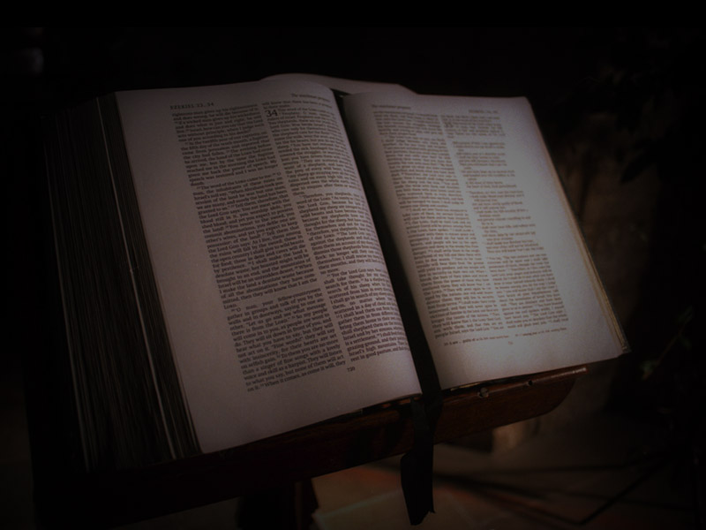
Getting to Know GOD…
“Thus says the LORD: "Let not the wise man boast in his wisdom, let not the mighty man boast in his might, let not the rich man boast in his riches, but let him who boasts boast in this, that he understands and knows me, that I am the LORD who practices steadfast love, justice, and righteousness in the earth. For in these things I delight, declares the LORD."
(Jeremiah 9:23-24)

Slide 9
Getting to Know GOD…
What Helps?
  God’s Creation (Rom. 1:20 Psa.19:1)
  The Scriptures (Gen.1-Rev.22)
  Godly lives (Gal.2:20; 1Cor.11:1)
  Moral & Spiritual Principles (Psa.7:17)
  God’s Providential Care (Acts 14:17; Matt.5:45; Rom.2:4; 2Pet.3:9; Rom.8:28)

Slide 10
Getting to Know GOD…
What Helps?
  Obedience (1Pet.1:16; 1 John 2:3-5)
  JESUS (John 1:18; Matt.26:28; Jer.31:34; Heb.8:12a)

Slide 11
omnipresent
Creator
Worship
spirit
supreme
love
GOD!
holiness
goodness
All-knowing
righteousness, kindness, graciousness
He is a God of wrath, anger, hatred,
abhorrence, displeasure, and fury

Slide 12
WORSHIP:
Life’s Greatest Moments
Ascribe to the LORD, O sons of the mighty,
Ascribe to the LORD glory and strength!
Ascribe to the LORD the glory due his name;
Worship the LORD in holy array
Psalm 29:1,2

